Slide 1
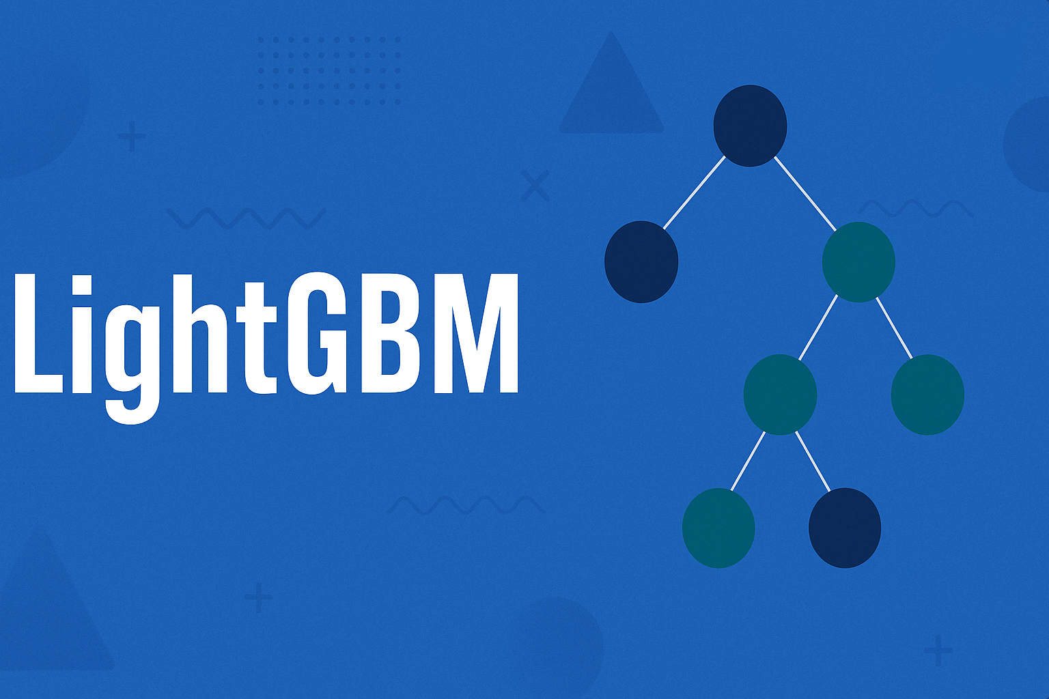

Slide 2
LG Boost (OR) Light Gradient Boosting Machine Algorithm
Light GBM is a fast, distributed, high-performance gradient boosting framework that uses a tree-based learning algorithm.
The word “Light” means this algorithm is superfast compared with other Boosting Algorithms.
The main difference between LightGBM and other Boosting algorithm is the way the tree is expanded.

Slide 3
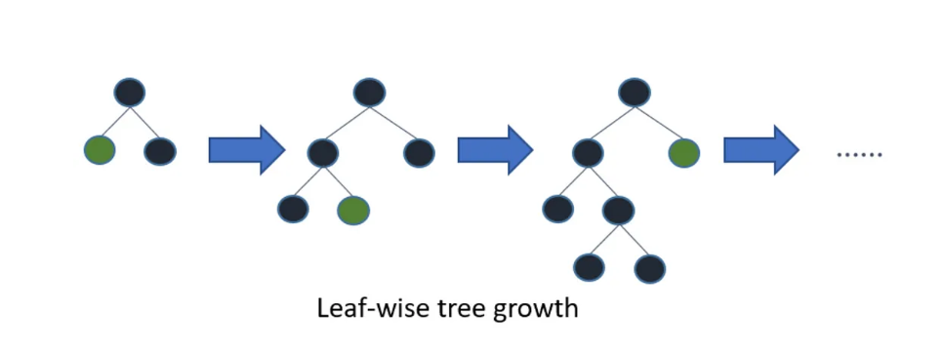
How Does LG Boost Work?
Light GBM splits the tree leaf-wise with the best fit.
Light GBM grows trees vertically while other algorithms grow trees horizontally.
Light BGM can handle the large size of Data and takes lower memory to Run.

Slide 4
LG Boost Algorithm Parameters
num_leaves - More number of Leaves means more complex model.
max_depth - Maximum depth of a tree
learning_rate - Shrinks the contribution of each tree
n_estimators - Number of trees
min_child_samples - Minimum number of data points in a leaf

Slide 5
Advantages of LG Boost
Faster training speed and higher efficiency
Lower memory usage
Better accuracy than any other boosting algorithm
Compatibility with Large Datasets

Slide 6
Disadvantages of LG Boost
Sensitive to overfitting
Compatibility with Datasets
Complex Parameter Tuning
Not Ideal for Small Datasets

